Slide 1
<!DOCTYPE html> <html> <head> <meta charset="utf-8" /> <title>Page Title</title> <style> .main { background-color:#F00; width: 200px; height: 300px; } fixed { position: fixed; bottom: 0; right: 0; width: 300px; border: 3px solid #73AD21; } </style> </head> <body> <div class='main'> <div id="box1"> <p class="fixed">static</p> <p class="relative" >relative</p> <!-- <img class="fixed" src="img/littleman.jpg"> --> </div> </body> </html>

Slide 2
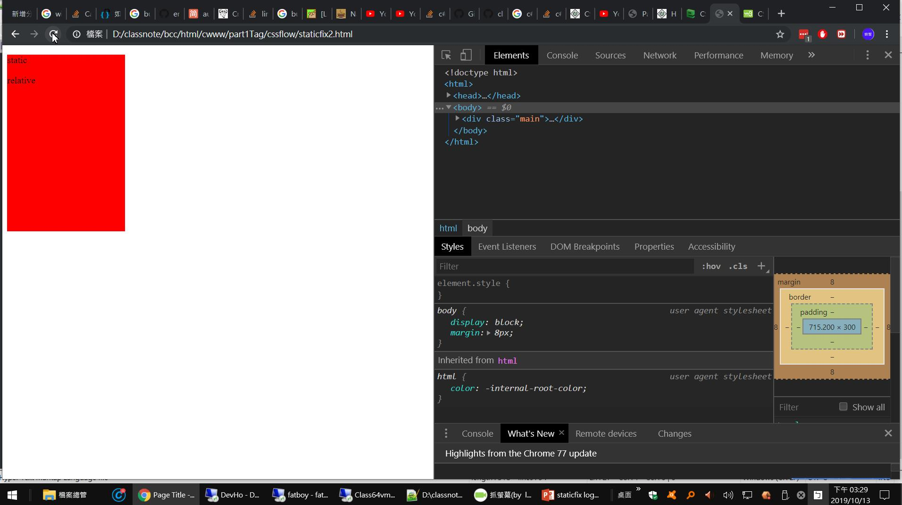
沒有在預期的位置

Slide 3
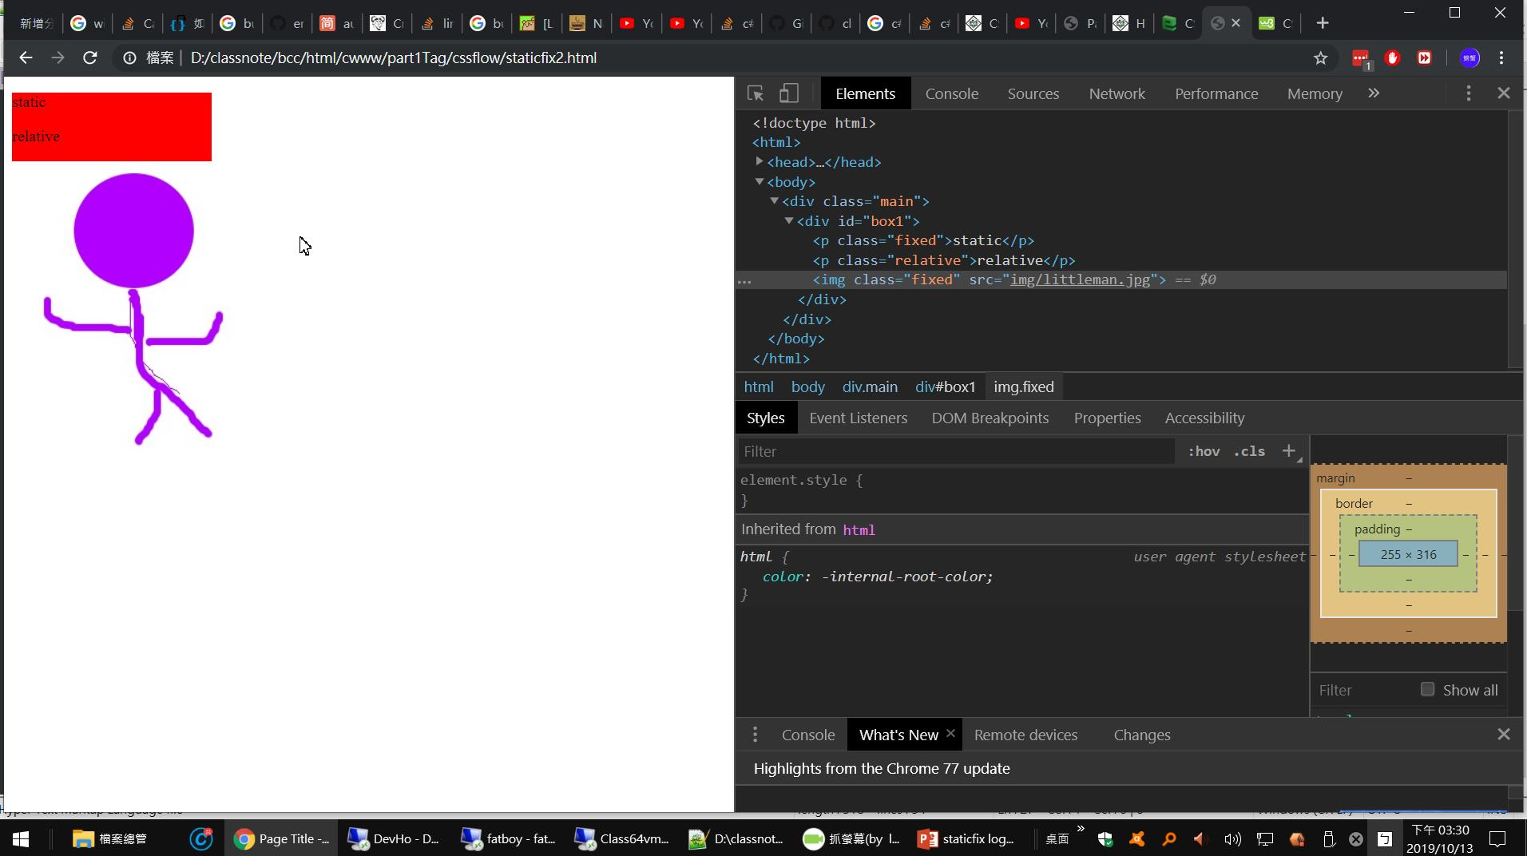

Slide 4
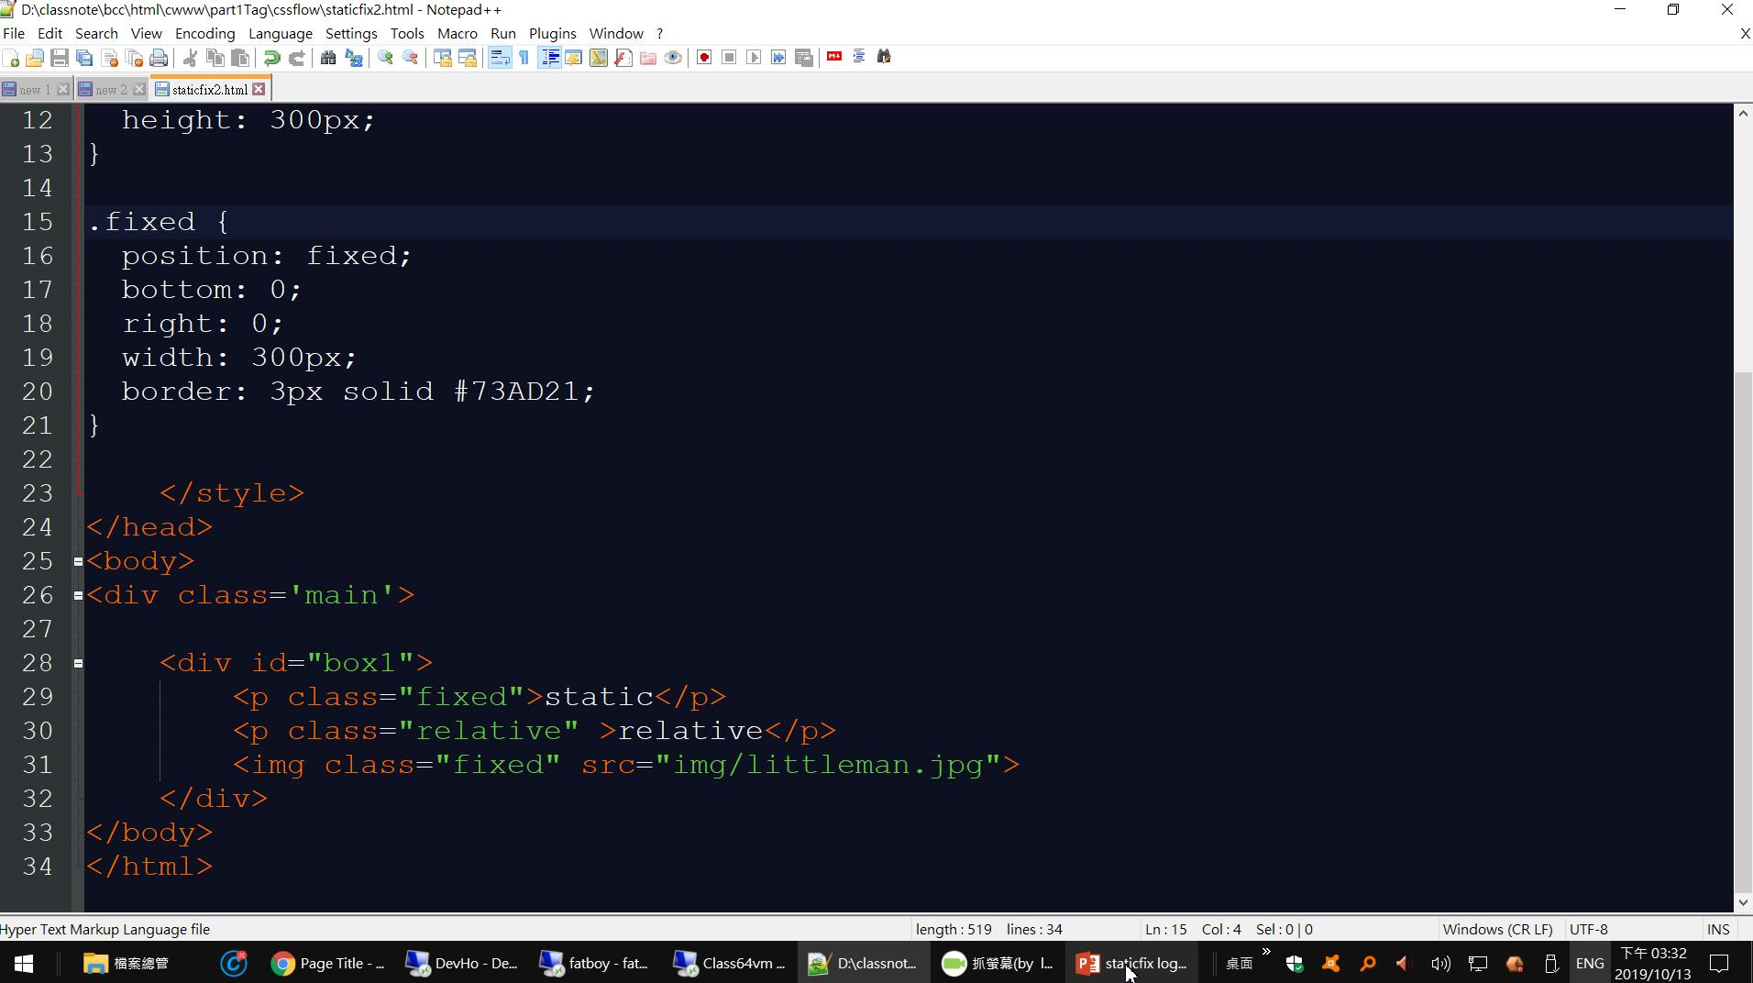

Slide 5
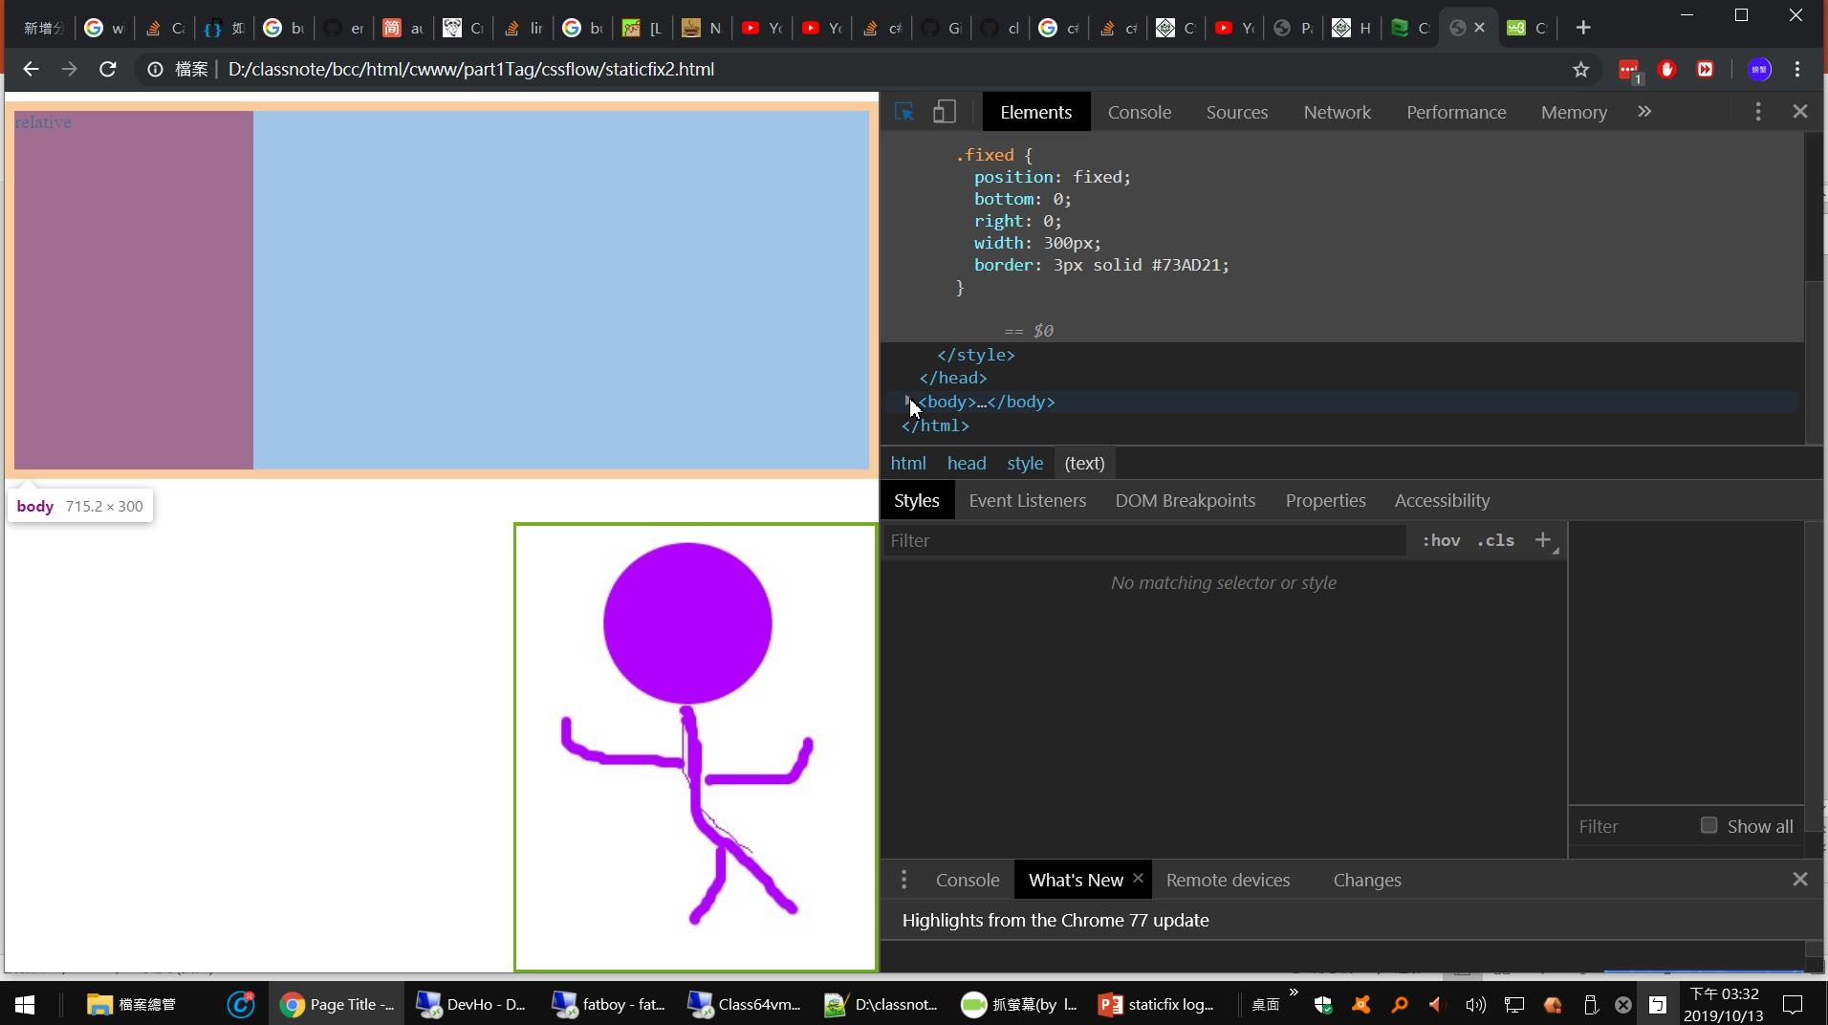
這是relative
static 在哪裡

Slide 6
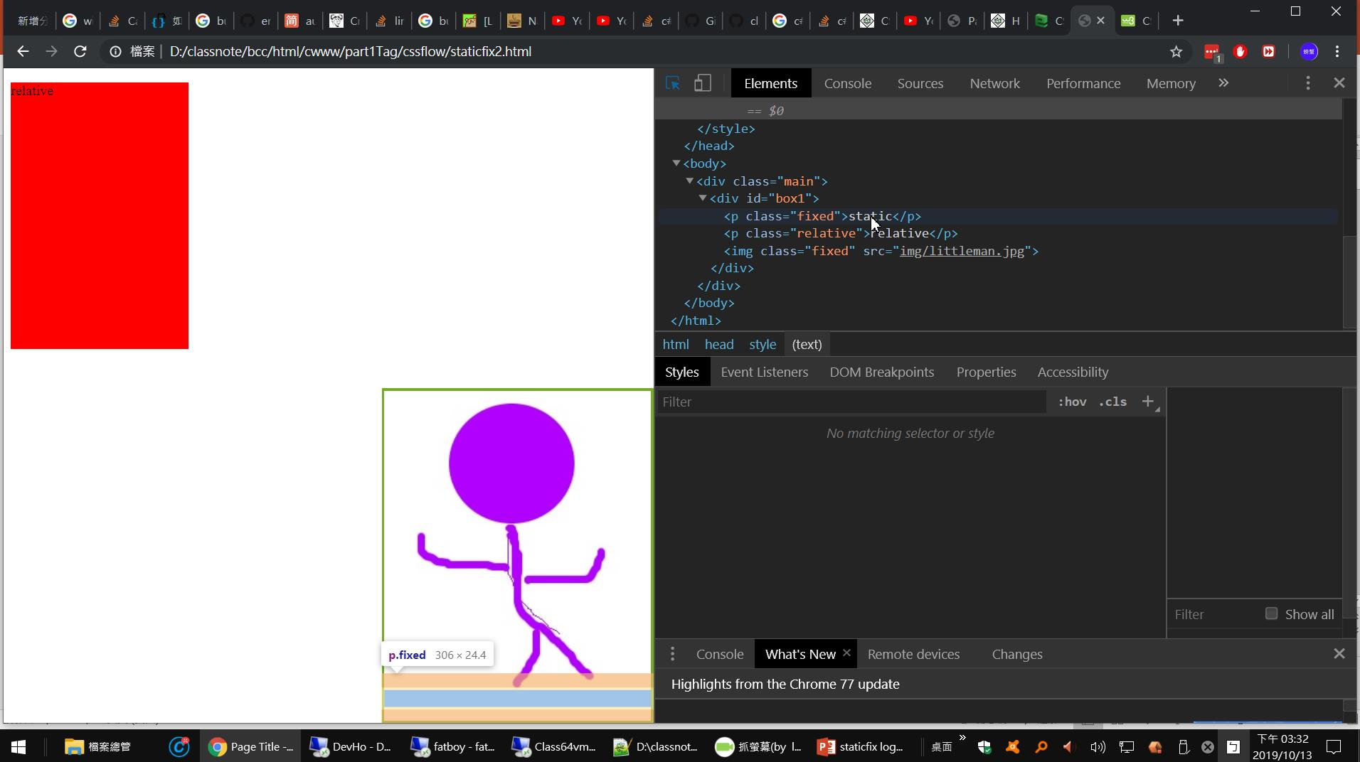
利用這個找

Slide 7
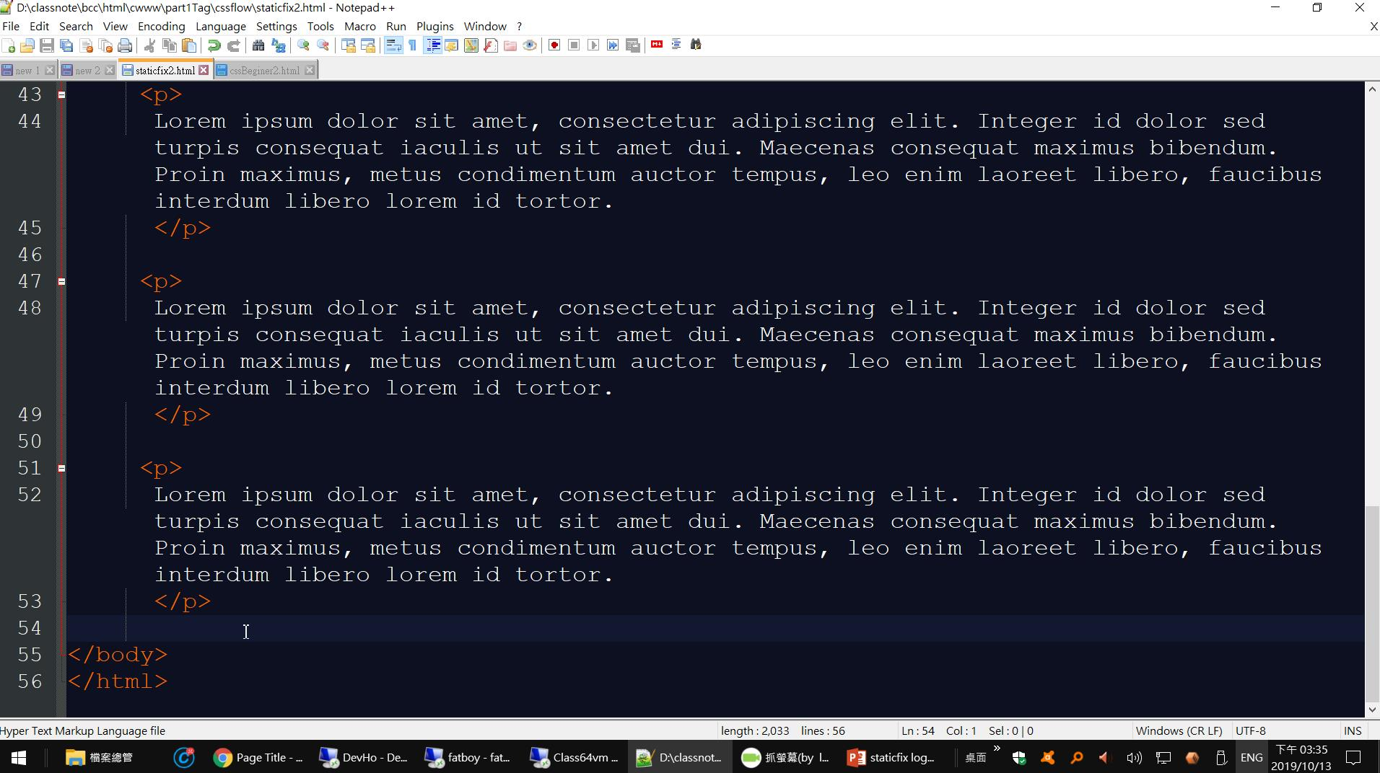
貼上一堆隨機文字段落

Slide 8
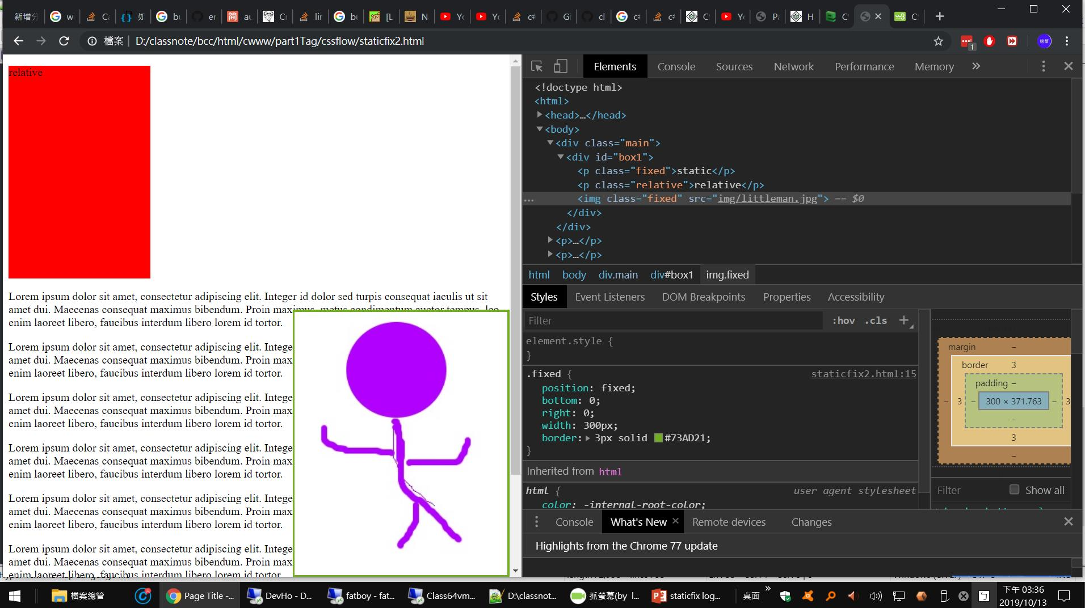
fixed { position: fixed; bottom: 0; right: 0; width: 300px; border: 3px solid #73AD21; }
不管怎麼移動,都在右下角
也就是相對於
viewpoint

Slide 9
The positioning is done relative to the first relatively (or absolutely) positioned parent element. In the case when there is no positioned parent element, it will be positioned related directly to the HTML element (the page itself).

Slide 10
<!DOCTYPE html> <html> <head> <meta charset="utf-8" /> <title>Page Title</title> <style> img { width: 100px; height:80px; } .absolute{ position:absolute; } .fixed { position: fixed; bottom: 0; right: 0; } img.absolute { position: absolute; top: 0; left: 0; } </style> </head> <body> <div class='main'> <p> in div.main</p> <div id="box1" class="absolute"> <p> box1</p> <img class="absolute" src="img/littleman.jpg"> <img class="fixed" src="img/littleman.jpg"> </div> </div> </body> </html>

Slide 11
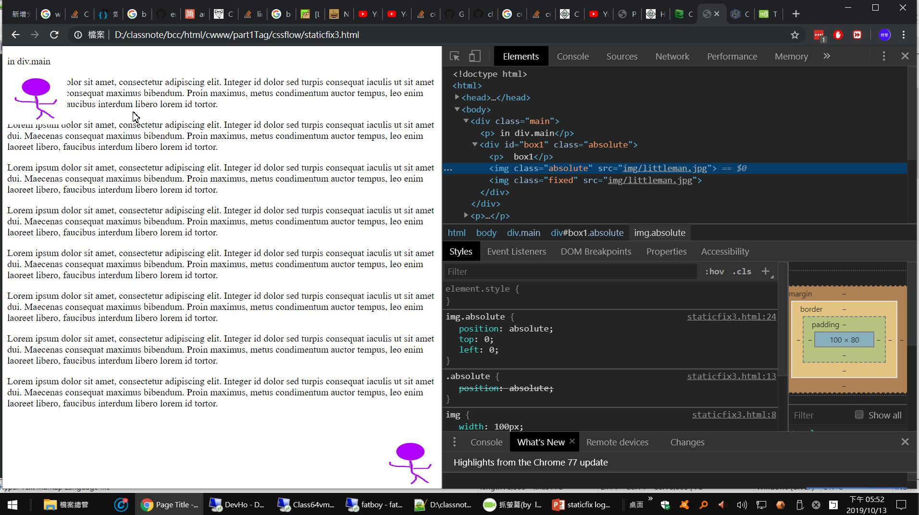
座標點相對於parent 中有absolute
如果都沒有,就是html
<div class='main'> <p> in div.main</p> <div id="box1" class="absolute"> <p> box1</p> <img class="absolute" src="img/littleman.jpg"> <img class="fixed" src="img/littleman.jpg"> </div> </div>

Slide 12
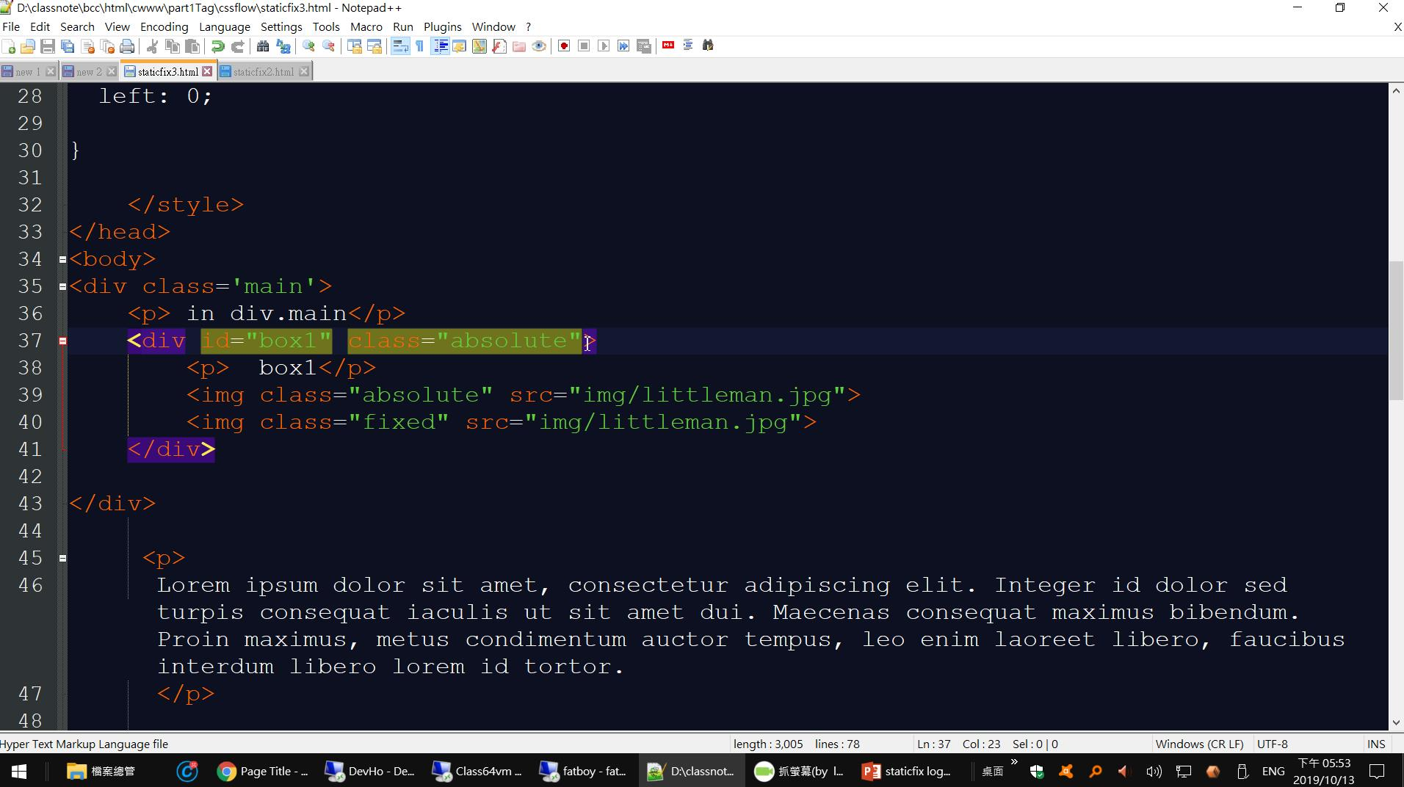

Slide 13
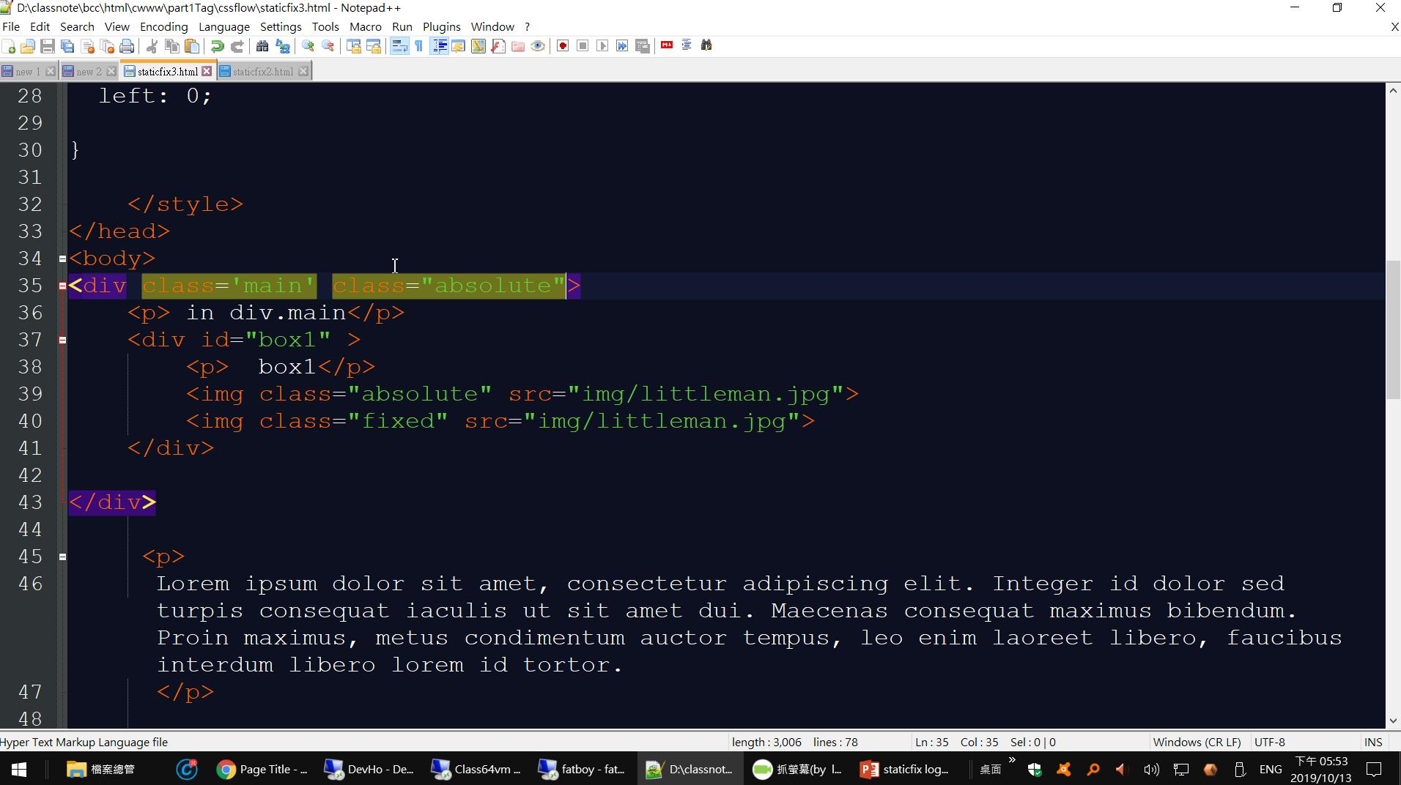
<div class='main' class="absolute">
<p> in div.main</p>
<div id="box1" >
<p> box1</p>
<img class="absolute" src="img/littleman.jpg">
<img class="fixed" src="img/littleman.jpg">
</div>
</div>

Slide 14


Slide 15
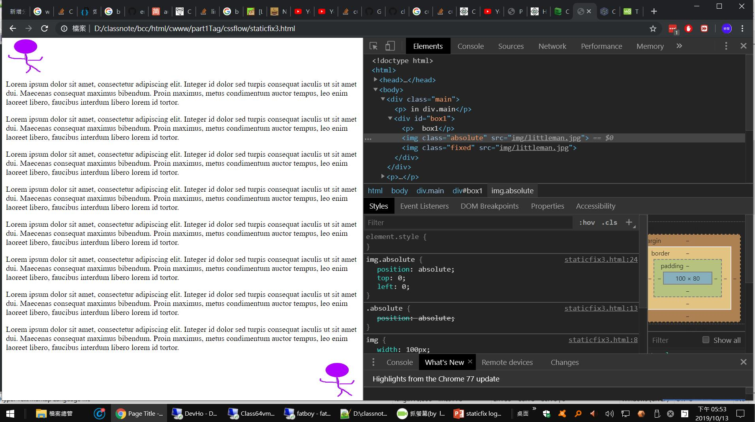

Slide 16
練習

Slide 17
透明圖片
img { opacity: 0.5; filter: alpha(opacity=50); /* For IE8 and earlier */ }

Slide 18
solution #1

Slide 19
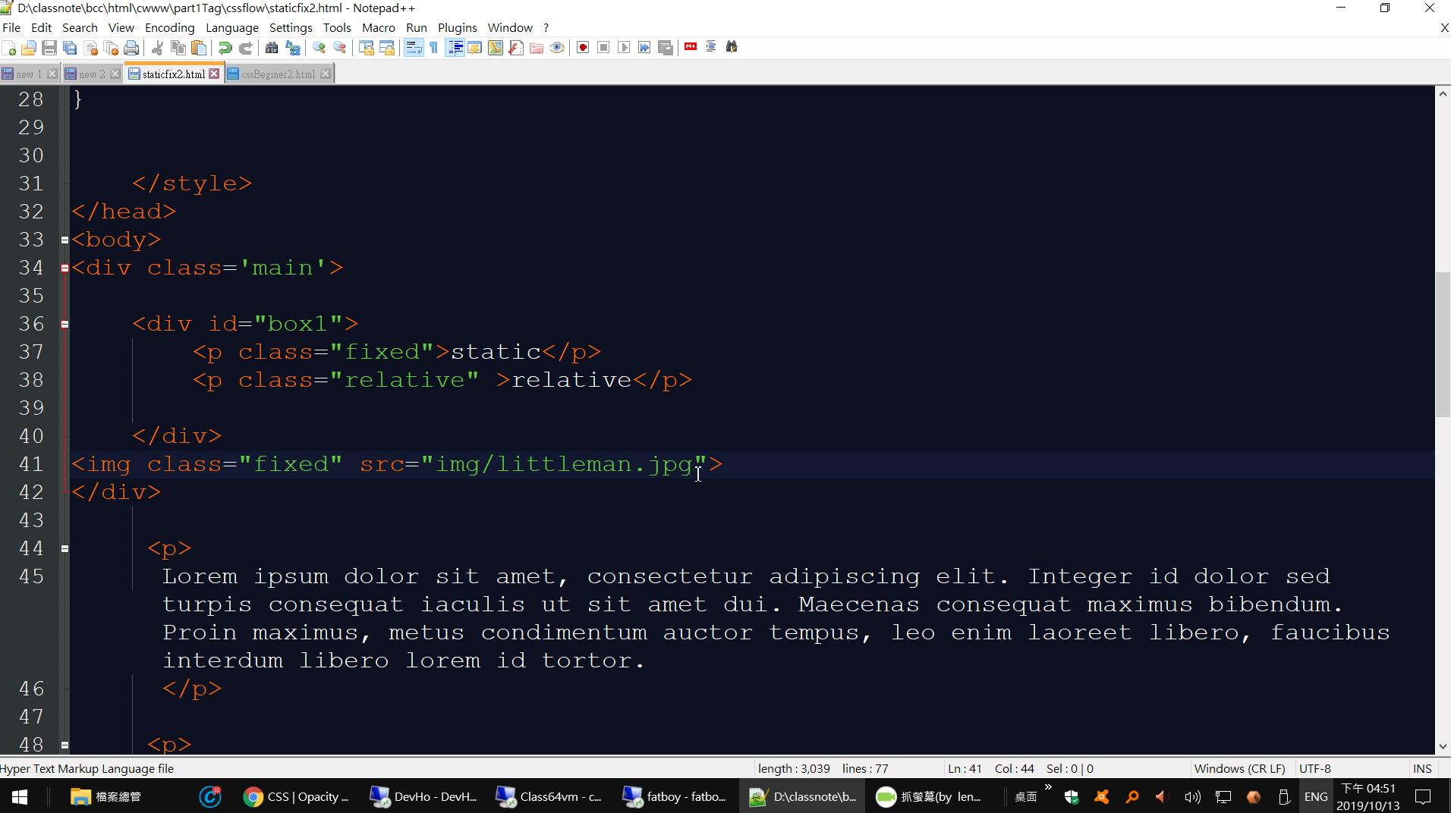
position absolute
opacity
衝突

Slide 20
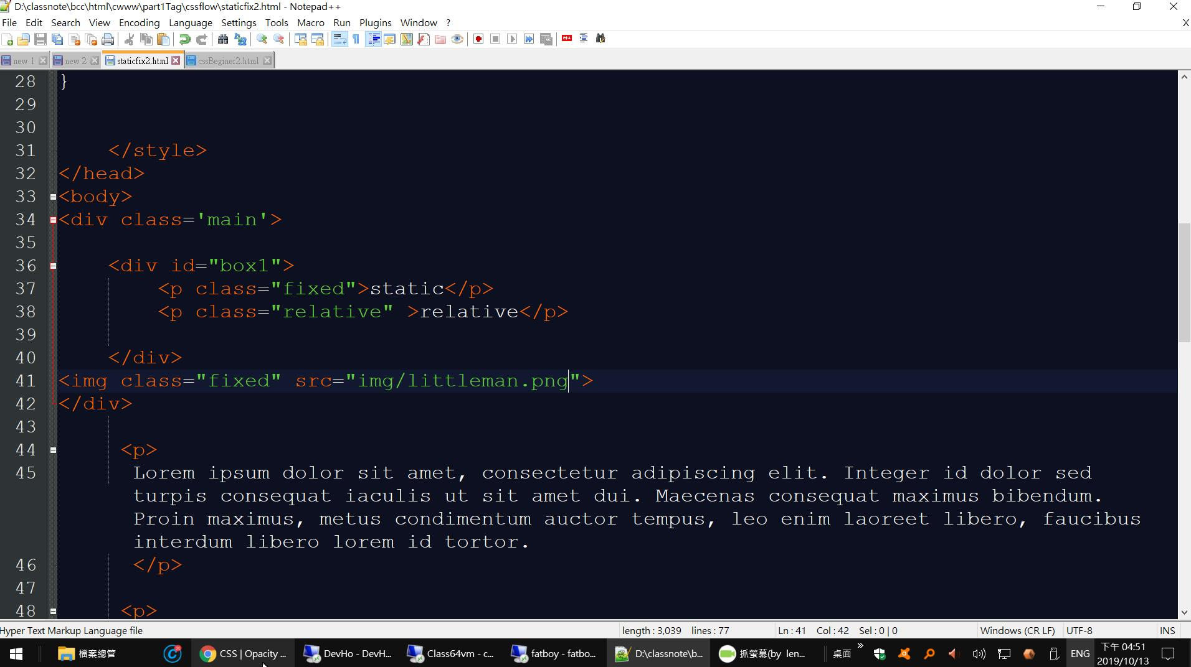

Slide 21


Slide 22
xx

